Slide 1
Ram Balak Mahto
Guest faculty
Department of Zoology
V.S.J College Rajnagar Madhubani Class 12th , 7908055676, rambalak85@gmail.com
Genetic Code part-2

Slide 2
Start and Stop Codons
Generally, AUG codon is the initiating or start codon. The polypeptide chain starts either with eukaryotes (methionine) or prokaryotes (N- formylmethionine).
On the other hand, UAG, UAA and UGA are called as termination codons or stop codons. These are not read by any tRNA molecules and they never code for any amino acids.

Slide 3
Non-ambiguous and Universal
The genetic code is non-ambiguous which means a specific codon will only code for a particular amino acid. Also, the same genetic code is seen valid for all the organisms i.e. they are universal.

Slide 4
Exceptions to the Code
The genetic code is universal since similar codons are assigned to identical amino acids along with similar START and STOP signals in the majority of genes in microorganisms and plants. However, a few exceptions have been discovered and most of these include assigning one or two of the STOP codons to an amino acid.
Apart from this, both the codons GUG and AUG may code for methionine as a starting codon, although GUG is meant for valine. This breaks the property of non-ambiguousness. Thus, it can be said that few codes often differs from the universal code or non-ambiguous code.

Slide 5
Characteristic of Genetic Code
The genetic code is the set of rules by which a linear sequence of nucleotides specifies the linear sequence of a polypeptide.
That is, they specify how the nucleotide sequence of an mRNA is translated into the amino acid sequence of a polypeptide.
Thus, the relationship between the nucleotide sequence of the mRNA and the amino acid sequence of the polypeptide is the genetic code.
The nucleotide sequence is read as triplets called codons.
PRINCIPLES OF THE GENETIC CODE
The genetic code consists of 64 different codons, each of which codes for 1 of the 20 amino acids.
A codon consists of a triplet of nucleotide bases.

Slide 6
SPECIAL CODONS
A. Chain Initiation Codons
The triplets AUG and GUG play double roles in E. coli.
When they occur in between the two ends of a cistron (intermediate position), they code for the amino acids methionine and valine, respectively in an intermediate position in the protein molecule.
But when they occur immediately after a terminator codon, they act as “chain initiation” (C.I.) signals or “starter codons” for the synthesis of a polypeptide chain.
They are also called chain termination codons because these codons are used by the cell to signal the natural end of translation of a particular peptidyl chain. However, their inclusion in any mRNA results in the abrupt termination of the message at the point of their location even though the polypeptide chain has not been completed.

Slide 7
Continue…..
B. Chain Termination Codons
The 3 triplets UAA, UAG, UGA do not code for any amino acid.
When any one of them occurs immediately before the triplet AUG or GUG, it causes the release of the polypeptide chain from the ribosome.
They are also called as stop codons.

Slide 8
Continue…..
C. Sense Codons
61 codons, which code for particular amino acids are termed as sense codons.
D. Non-Sense Codons
Triplets UAA, UAG, UGA do not code for any amino acid.
They were originally described as non-sense codons.
However, the so-called non-sense codons have now been found to be of “special sense”.
These special-sense codons perform the function of punctuating genetic message like a full stop at the end of a sentence.

Slide 9
PATTERNS OF THE GENETIC CODE
Amino acids with similar structural properties tend to have related codons.
Aspartic acid codons (GAU, GAC) are similar to glutamic acid codons (GAA, GAG); the difference being exhibited only in the third base (toward 3′ end).
Similarly, the codons for the aromatic amino acids phenylalanine (UUU, UUC), tyrosine (UAU, UAC) and tryptophan (UGG) all begin with uracil (U).
All codons with U in the second position specify hydrophobic amino acids (Ile, Leu, Met, Phe, Val).
All codons with A in the second position specify the charged amino acids, except Arg.
All the acidic (Asp, Glu) and basic (Arg, Lys) amino acids have A or G as the second base.

Slide 10
READING FRAMES AND OPEN READING FRAMES

Slide 11
Continue…..
The mRNA sequence can be read by the ribosome in three possible reading frames.
Usually only one reading frame codes for a functional protein since the other two reading frames contain multiple termination codons.
However, in some bacteriophage, overlapping genes occur which use different reading frames.
An open reading frame (ORF) is a run of codons that starts with ATG and ends with a termination codon, TGA, TAA or TAG.
Coding regions of genes contain relatively long ORFs unlike non-coding DNA where ORFs are comparatively short.
The presence of a long open reading frame in a DNA sequence therefore may indicate the presence of a coding region.
Computer analysis of the ORF can be used to deduce the sequence of the encoded protein.

Slide 12
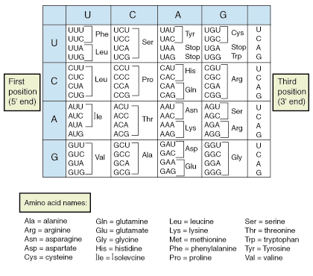
Table of genetic code

Slide 13
THE END Thank u

